Slide 1
DSA
Lecture#12

Slide 2
Shortest Path Algorithm
An algorithm that is designed to find a path of minimum length between two specified vertices of a connected weighted graph.

Slide 3
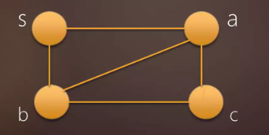
Single source shortest path algorithm
It determines the cost of shortest path from a source vertex u to a destination v.

Slide 4
Dijkstra’s Algorithm
It is a greedy algorithm for solving a single source shortest path problem.
Provides us with the shortest path from one source node to all other nodes in the given graph.

Slide 5
Rules of Dijkstra’s algorithm
It can be applied on both directed and undirected graph.
It is applied on weighted graph.
For the algorithm to be applicable the graph must be connected.

Slide 6
Cont…
In Dijkstra’s algorithm always assign source vertex to zero distance.
Assign every other node a tentative distance.

Slide 7
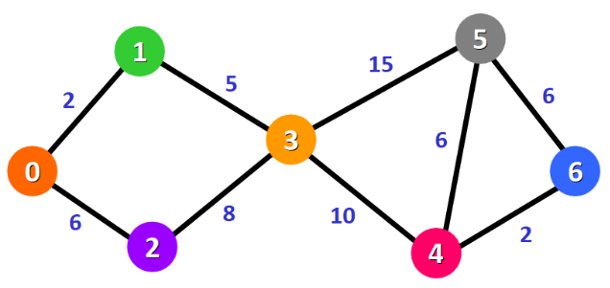
Example#1
Find the shortest path from node 0 to all other nodes in the graph.

Slide 8
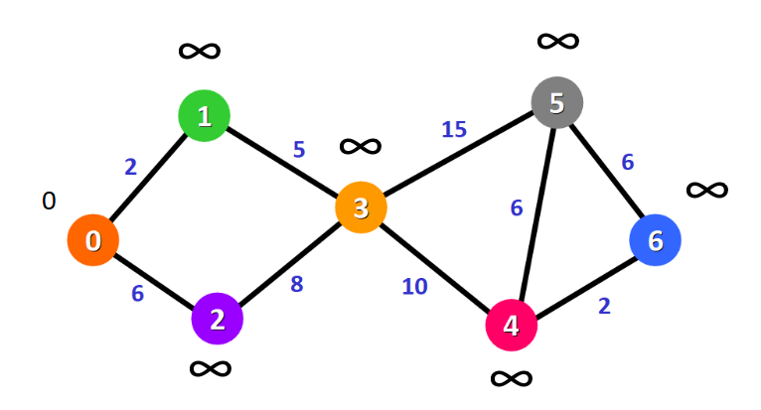
Cont…

Slide 9
Cont…
Formula:
d(u)+c(u,v)<d(v)
Solution:
For node 0 to 1:
d(u)+ c(u,v)< d(v):
0+6<∞
6<∞
d(v)=6

Slide 10
Cont…
For node 0 to 2:
d(u)+ c(u,v)< d(v):
0+2<∞
2<∞
d(v)=2
Repeat the formula for 0 to all the other nodes.

Slide 11
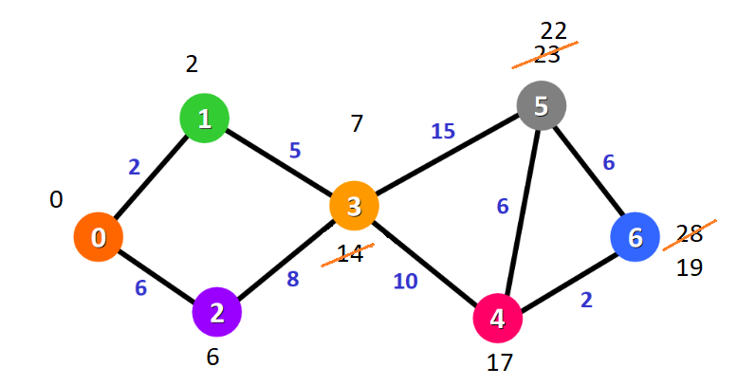
Cont…

Slide 12
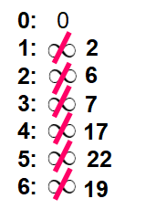
Cont…
Distance:

Slide 13
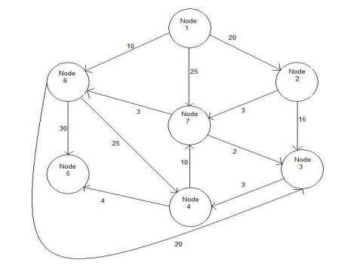
Class Assignment
Find the shortest path from source 1 to all other nodes using Dijkstra algorithm.

Slide 14
THANK
YOU

